Slide 1

Penetration Testing and Metasploit
Pruthvi Palanpurwala & Connor Vandenheede

Slide 2
Agenda
Pen testing:
Description
Purpose
Reasoning
Process
Exploitation
Reporting
Metasploit:
Description
Modules
Msfconsole
Demo
Stats

Slide 3
What is penetration testing?
A simulated, authorized attack on an organization’s (computer) systems and applications, in order to demonstrate security vulnerabilities so they may be fixed
Notes:
Computers are the hub of almost all valuable information now, but anything storing valuable data is a target

Slide 4



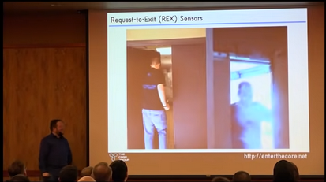
The broad field of security testing
Pentesting can be applied across many domains: physical security, social engineering, software, network security… And they all overlap
https://www.youtube.com/watch?v=pL9q2lOZ1Fw
https://www.youtube.com/watch?v=rnmcRTnTNC8

Slide 5


The Role of Pentesting
Pentesting is focused on exploiting known vulnerabilities in specific technologies
“If you fail a penetration test you know you have a very bad problem indeed. If you pass a penetration test you do not know that you don’t have a very bad problem”
Vs.
Notes:
A good way to think of the pentesting is that you can be sure a good pentester tried everything on the CVE, but your niche web app might have a zero-day exploit that gets missed. So, you can be sure there’s no holes in your boat right now, but there might be a big crack that’s painted over!

Slide 6

Why do penetration testing, then?
Pros:
Fast
Cheap (relatively)
Cons:
Easy to miss new / novel bugs
Only done late after software is developed and deployed; bugs could be exploited
Notes:
https://www.rifemagazine.co.uk/2016/11/feature-time-is-money/

Slide 7

Different Classes of Pentesting
Initial system knowledge:
Notes:
https://medium.com/@mcccccc/difference-among-white-box-black-box-and-grey-box-testing-35482292473f

Slide 8

Different Classes of Pentesting
Initial network access:
Internal
External
Notes:
External is the position of any random person unaffiliated with the target; Internal is not necessarily an employee, but someone who has access rights like a user, e.g. someone with phished credentials

Slide 9

Different Classes of Pentesting
Initial attack awareness:
Blind
Double-blind
Targeted testing
Notes:
https://www.hifi-advice.com/blog/audiophile-insights/generic-insights/double-blind-listening-tests/

Slide 10
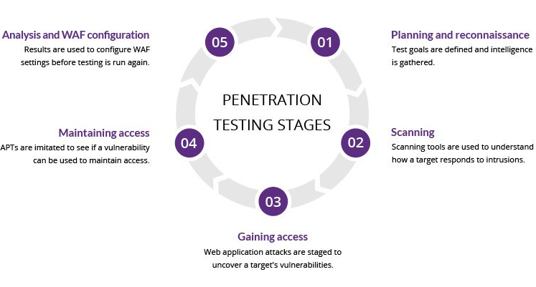
Pentesting Phases
Many different methodologies, but all follow the same general path:
Reconnaissance
Scanning
Exploit
Post-exploit
Reporting
Source: https://www.imperva.com/learn/application-security/penetration-testing/
Notes:
Different methodologies, but similar format of
Recon and scanning
Then exploitation
Followed by post exploitation
And then reporting
We’ll go into more detail about each starting with recon

Slide 11




Reconnaissance
Gather as much initial data about the target as possible
company/organization info (websites, employees, linkedin, social media),
system info (machine architecture, network structure, software in use)
OSINT (open source intelligence)
Honey Pots
Notes:
Recon is the act of gathering as much info about the target system or its users as you can while doing it discretely because you dont want to draw attention.
The processes and techniques involved can be anything from:
Checking company or organizational info
Social media
System info
Using open source intelligence tools
Or in some cases even setting up honeypots for credentials
Example: you can check if a users email has been leaked anywhere via haveibeenpwned, and see if you can find the leak for a possible password to try on the system

Slide 12



Scanning
Actively looking at what’s running on a target system
Often bundled with vulnerability analysis: what is running on the open ports of a system, and what might they be vulnerable to?
automated (e.g. Nessus, accessible within Metasploit) or manual (tester’s knowledge of vulnerabilities)
Fuzzing: finding vulnerabilities by providing invalid or unexpected input data
Notes:
The scanning phase is like the active part of recon, particularly looking at data from scans.
In pentesting, this involves tools like nmap to try and figure out information about services running on the machine to search for security flaws.
Simply put, this is the phase where you look for attack vectors and probe the system for any.

Slide 13




Exploitation
Leveraging the information from Recon and Scanning to gain initial control of the system
You can’t exploit a system that doesn’t have a vulnerability! (that you know about)
Notes:
The next phase is exploitation.
Based on information gathered from scanning and recon, you can search for exploits that may work.
Of course, the more knowledge you have about the systems flaws, the easier this phase will be.
It’s much more difficult to try and find an exploit on a system you know nothing about, which is why the first two phases are so important.
An example of this would be if you learned a system has an older version of log4j, then you could look for ways to use the recent exploit on it.

Slide 14




Post-exploitation
What you do once you’re in:
privilege escalation
persistence
data exfiltration
covering tracks
Notes:
Post exploitation refers to things an attacker might do after infiltration.
So things like privelege escalation,
Persistance for long term access,
Breaching or leaking data,
Pivoting to other systems and so on.
One of the most important steps an attacker could take post exploit is covering their tracks. If the system doesn’t know theres an infiltrator, then theres a lower chance they’ll update their security.

Slide 15


Reporting
Present a deliverable to the client who owns the system:
Summary of vulnerabilities found, written towards non-technical users
Detailed actions taken during the test
Information and credentials obtained (censor private data!)
Patches and mitigations recommended and/or applied during the test
Notes:
Reporting is the last phase in the process.
This includes things like showing a user or a client how successful attacks were executed,
What information was obtained,
The consequences of a breach,
And most importantly, how to fix the issues.
After patches are applied, its good to double check security by trying the same exploits again.
Even if it might seem like a boring phase, documentation is very important so that the same mistakes arent repeated.

Slide 16





We’ve encountered a lot of the tools and techniques used at each phase of pentesting. What about software can do nearly it all? Or at least, brings these tools together to streamline the process and allow quicker and more efficient pentesting?
Notes:
There are plenty of tools to help the pentesting process, and many for specific phases too.
We are familiar with a bunch like wireshark, nmap, john, burp and so on.
However, there is a tool that streamlines the entire process we just went through and that is metasploit.

Slide 17

Metasploit Framework
A powerful open source pen testing tool
Developed by rapid7
Used by professionals, cyber criminals
Currently has a professional version (for commercial use)
  Deeper webapp testing
  Dynamic payloads to try and avoid antivirus detection
  Web interface
  etc
Notes:
Metasploit is a powerful open source pen testing tool being developed by rapid7 which is a cyber security company.
Its used by both industry professionals and cyber criminals due to the vast array of tools and options it provides in exploiting vulnerable machines.
Currently, it's a free tool with paid options and a commercial use option costing roughly $15000 yearly.
Of course, the paid verisons come with more tools and perks like further web application testing,
dynamic payloads to avoid detection of malicious activity,
a usable web UI and more.

Slide 18

MSF Brief History
Originally created by H. D. Moore in 2003
  First released with 11 exploits
Metasploit 2.0, April 2004
  Included 19 exploits and 27 payloads
Metasploit 3.0, perl to ruby rewrite by 2007
Acquired, by Rapid7 in 2009
Notes:
A bit of history about it, it was originally created in 2003 by H D Moore, who was a network security expert
and the first version released with 11 exploits.
Then, in 2004, 2.0 was released which now included 19 exploits, and 27 payloads.
Later, in 2007 it was rewritten to ruby from perl as the 3.0 version for compatibility reasons
and finally
in 2009, it was acquired by rapid7 who still maintain and develop it.

Slide 19
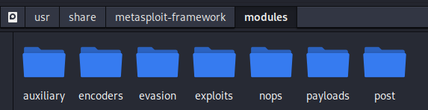
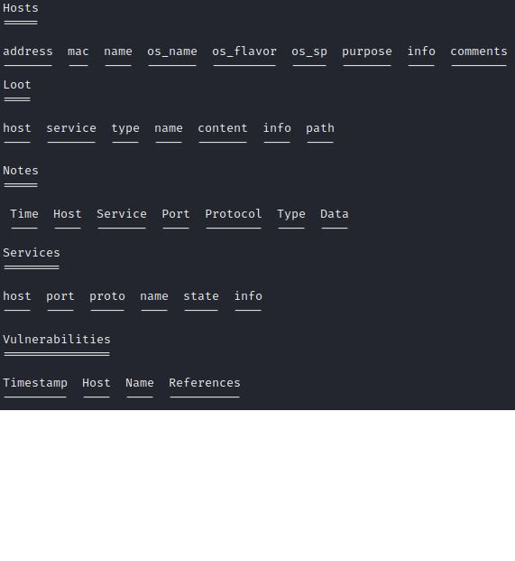
About
many ready to use modules organized by purpose
Internal postgresql support
  Stores connected hosts
  Records nmap results to table
  Any discovered credentials
  Stores ‘loot’
    Hash Dumps obtained from system
  All exportable to CSV
Notes:
Metasploit is built up of modules, where each module is organized by purpose.
So you can see the folder structure under modules contains many different types, and we'll go deeper into most of them to see what they're about.
Metasploit also has postgresql support to run its own database.
It's very useful in staying organized and it keeps track of things for you.
You can see some of the takes on the side,
but essentially it can do things like
store connected host information,
store nmap results,
store discovered credentials,
store 'loot' which are any hashdumps obtained from a system, ready for John The Ripper,
and all the tables are exportable to CSV, which can be helpful for reporting.

Slide 20
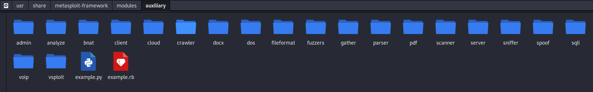
Modules
Auxiliary: Scanning tools as well as many other useful tools
port scanners
fuzzers
sniffers
Analysis tools like password crackers
If you need something that’s not in one of the other module dirs, look in here
Notes:
Taking a look into the first module type, we have the auxiliary modules.
These modules dont really have a simple shared goal that they all try to accomplish.
Instead, its more like a collection of tools that can perform things like
scanning,
fuzzing,
sniffing,
password cracking,
brute forcers and so on.
It also contains tools for specific software so if you notice a system running something like mySQL, you can try to use the sql scanner in this module.

Slide 21
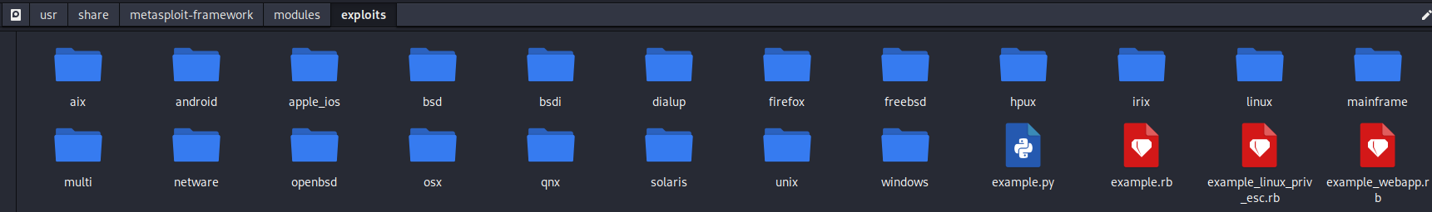
Modules
Exploit:
Executes a sequence of commands or scripts to target vulnerabilities in the system
Contains thousands of known exploits with information about platforms they can affect
Once a machine is targeted, metasploit can help narrow down possible exploits that may work
Notes:
There are thousands of exploits, and are labeled with things like the operating system, programs, or versions the exploits are meant for.
This is why knowing information about the system beforehand makes it a lot easier to find and narrow down on exploits, because metasploit has them all well organized
and easily findable.

Slide 22
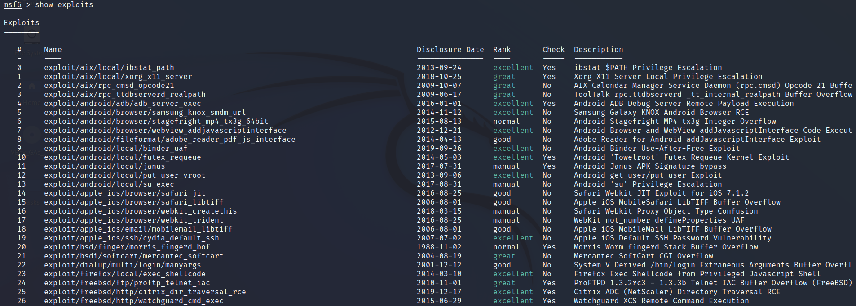
Notes:
So this is typically the information that shows up when you look for exploits in metasploit.
The first column is the name, and you can see it tells us that the exploit is for IOS,
its a browser exploit, and specifically for safari.

Slide 23
Notes:
The date column is simply just the date the exploit was disclosed, so it's also possible to search for exploits from a certain time.

Slide 24
Notes:
The rank of an exploit usually indicates how likely it is to work. We'll take a closer look at the ranks in a bit,
but Generally, you want to use the highest rank exploit applicable to your target for the best chance of success.

Slide 25

Notes:
The check column is either a yes or a no.
A yes means that if you work with the exploit,
you'll be able to check if it will be successful on a target system beforehand without actually having to run the exploit.
A no means that it can't check if it will work on the system beforehand or not.
Generally, most of the exploits dont really support checking yet.

Slide 26
Notes:
The description column just gives a little bit of info about the exploit, so for example
this one exploits executing shellcode from a privileged javascript shell.

Slide 27
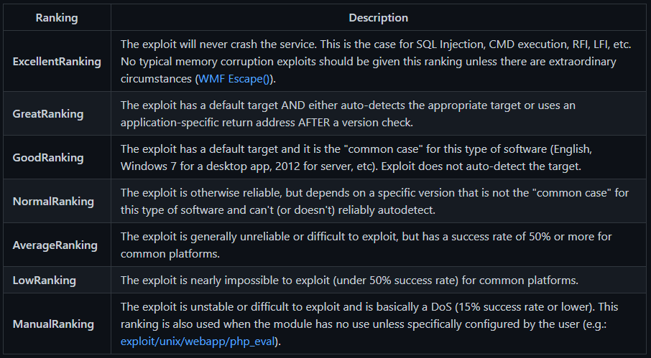
Notes:
So here's the list of rankings from before.
Generally, they're based off of how reliable an exploit is, but not entirely.
If we look at the description for the Normal Rank, it mentions that the exploit itself is reliable,
but the software it depends on is not easy to detect or requires a very uncommon version.
So, they are ranked by other factors as well, not just the reliability of the exploit itself.

Slide 28
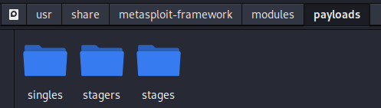
Modules
Payloads:
Malicious code to be executed on target systems
Attached to exploits
Once exploit is successful, payload will execute
Singles, Stages, Stagers
Reverse shell, Meterpreter etc
Notes:
The third module is payloads.
Payloads are basically malicious code the hacker can use to interact with the exploited target system.
Once an exploit is successful, the payload will execute and give you things like a shell, or manipulate a file.
One of the more popular payloads to use in metasploit is called meterpreter.
It's an advanced payload kind of like a terminal except it comes with its own modules and actions you cant do with a regular terminal.
Payloads are subdivided into 3 types,
singles,
stagers,
and stages.
Singles contain all the code they need to execute, so they execute in 1 go.
They are useful for accomplishing one and done tasks like for example creating a user on the system.
Depending on the task being done, they can be small or large since they self contain all the needed data for a task.
Stagers on the other hand usually establish some form of communication between the attacker and target systems, and tend to be of a small size.
They use this communication to set the stage for the the 'Staged' payloads.
Stages are much larger payloads, and stagers use the communication form to download them onto the target.
Stages are much more capable, and offer the most control. An example of a stage would be something like meterpreter.

Slide 29
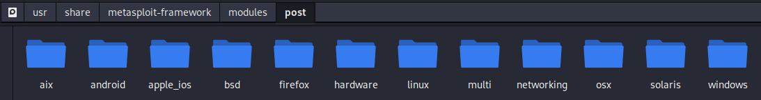
Modules
Post:
After exploit and successful payload
Post-Exploit
  Search file system
  Run meterpreter actions
  Gather system information
  Pivot from the system to other systems
  etc
Notes:
The post module simply stands for post exploit, and contains things you might be able to use after a successful exploit.
This includes things like we discussed in the Post-Exploit phase like privelege escalation, downloading data, pivoting and so on.

Slide 30

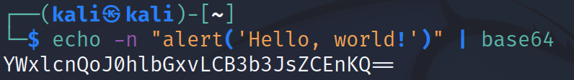
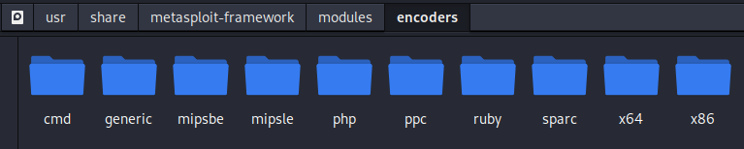
Modules
Encoders:
How can payloads try to sneak past AV memory scan/signature detection/YARA rules?
Encoders are like obfuscation for payloads
Fixes possible issues
Does not change functionality of the payload itself
Notes:
The encoders module helps answer the question of how a payload could bypass detection or YARA rules.
Passing a payload through an encoder is somewhat the equivalent of running code through an obfuscator.
Just like obfuscation, the payload functionality isn't changed.
It can also help the payload execute in some cases by dealing with problems like null bytes interfering with shell code or string termination.

Slide 31
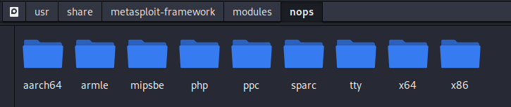
Modules
Nops:
Basically an instruction that does nothing for 1 cycle
Useful for padding payload for consistent size
Can be used to try and aim to run the payload in a specific part of memory if it is required
Notes:
The last module we'll talk about is the NOPS module.
Nops being no operations, just instructions that do nothing for 1 cycle.
This module makes it easier for payloads to have a consistent size if it's needed by adding nops to the start or the end of the payload.
It's also useful for memory based payloads since you can try to 'aim' where the payload runs in memory by specifying a specific number of nops.

Slide 32
msfconsole
The standard CLI for working with the Metasploit framework
Provides quick access to the msf database (previously connected hosts, discovered services, vulnerabilities, variables…)
Standard terminal commands still work

Slide 33
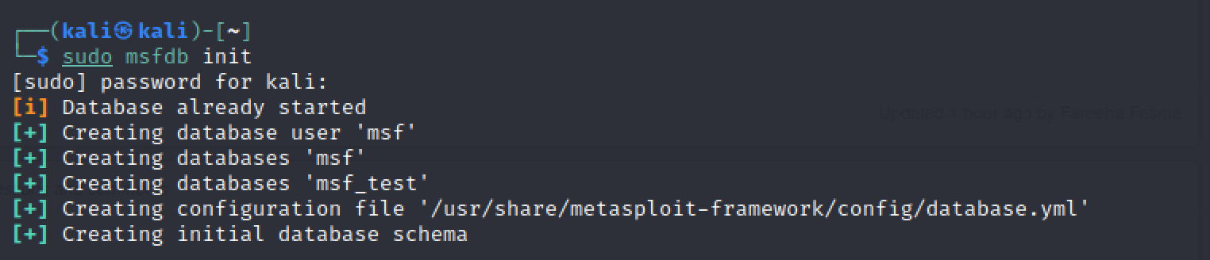
msfdb
Metasploit uses “workspaces” to organize target data gathered in a session(s)
Must have postgres service running:
Database must be initialized the first time it’s used:

Slide 34
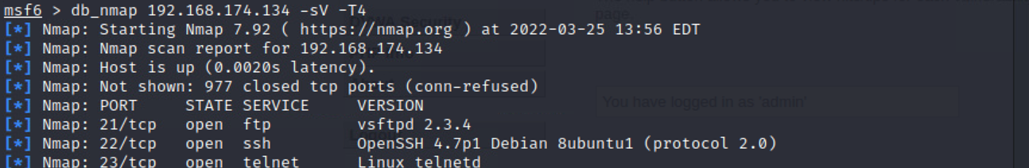
msfconsole commands
db_nmap: automatically adds scanned hosts and discovered services on them to the msf database
services: displays information gathered from all db_nmap scans in the current workspace

Slide 35
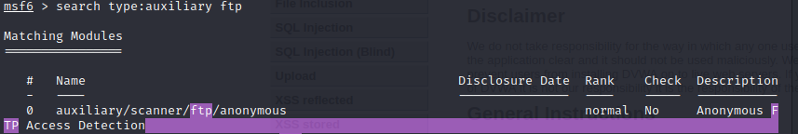
msfconsole commands
search: can search through module types, names, keywords, CVE/ other identifiers for vulnerabilities

Slide 36
msfconsole commands
use: load a module

Slide 37
msfconsole commands
show
Most common:
options
info
payloads

Slide 38
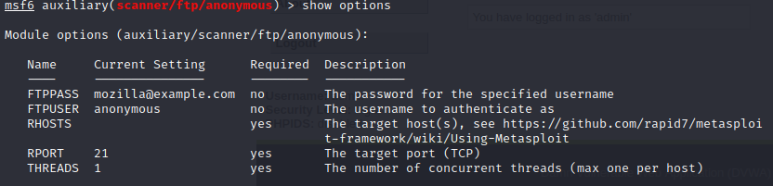
msfconsole commands
show options
display all of the loaded module’s configuration options
Most common setting is RHOSTS, which are the target(s) IP(s)

Slide 39
msfconsole commands
show options
display all of the loaded module’s configuration options
Most common setting is RHOSTS, which are the target(s) IP(s)

Slide 40
msfconsole commands
Set

Slide 41

msfconsole commands
run / exploit
run the loaded module with current configuration settings

Slide 42
Msfconsole commands
Database commands:
Hosts
Services
Vulns
Loot
Creds

Slide 43
Meterpreter
Advanced reverse shell included in many payloads
Runs in memory, attached to an existing process
Many useful tools to help accomplish tasks on the target system, including scripts and msf post modules
A common goal post-exploit is to upgrade a regular shell to meterpreter

Slide 44
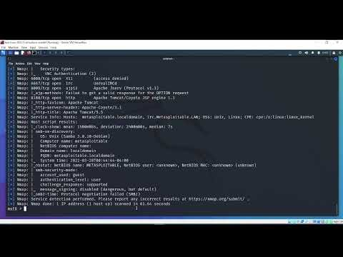
Demo

Slide 45
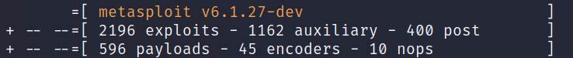
Metasploit stats
Contains over 2000+ exploits for 25+ platforms
  AIX, Android, BSD, BSDi, Cisco, Firefox, FreeBSD, HP-UX, Irix, Java, JavaScript, Linux, mainframe, multiplatorm, NetBSD, NetWare, nodejs, OpenBSD, macOS, PHP, Python, R, Ruby, Solaris, Unix, and Windows
hundreds of payloads
Notes:
So some very quick stats about metasploit,
it has over 2000 available exploits for those 25 platforms listed,
and it has hundreds of payloads available to use as well.
The picture is an example output of what my VM installation of this metasploit version has for all the modules we talked about.

Slide 46
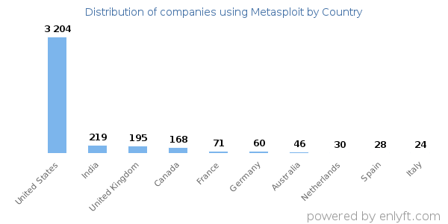
Metasploit usage stats
Notes:
==== USAGE ====
Here's a graph of where companies that use metasploit are located,
of course the US has the most users, probably because metasploit itself is an american company.

Slide 47
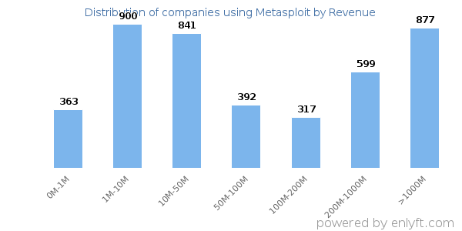
Metasploit usage stats
Notes:
Heres a graph of metasploit usage based off of revenue, so as you can see many of the larger companies with over a billion dollars in revenue also seem to use it.

Slide 48
Overview of steps
i) Recon and Scan target for vulnerabilities to exploit
ii) Choose an appropriate exploit based off of step i)
iii) Choose an appropriate payload that accomplishes what you want to accomplish
iv) Optionally encode the payload
v) Run the exploit
Notes:
So in summary for the metasploit framework, it really boils down to these 5 basic steps.
The first thing you want to do is recon and scanning on the target machine for vulnerabilities.
The second thing you want to do is search metasploit for appropriate exploits from your findings, preferrably one with a high ranking.
Then, the third thing you want to do is choose and configure a payload that does what you want, which most probably would be a shell.
Fourth, optionally you can encode the payload whether that be for security reasons or just obfuscating
And finally fifth, you just run the exploit and hope it works.

Slide 49
Who does pentesting?
Professionals who provide testing as a service to companies, governments and organizations
Training to get certified:
OSWE (Offensive Security Web Expert)
GWAPT (GIAC Web Application Penetration Tester)
CWAPT (Certified Web App Penetration Tester)
eWPT (elearnSecurity Web Application Penetration Tester)
Students (us), to learn about securing any applications we might develop / our own networks

Slide 50
The End
Questions?

